Slide 1
Part 1: Introduction Txt, chapter 1

Slide 2
Summary
Contact information
Course objective and topics
Course evaluation
* The layering principle of network protocols
* Connection-oriented and connectionless services
Service primitives
The relationship of services to protocols
* Reference models

Slide 3
(1) Contact Information
Professor: Justus Nyamweya Nyagwencha
Email: jnyagwnecha@usiu.ce.ke
Class Time: 7:00 – 9:00 pm
Office hours:
MW 10:00-11:00 am, 01:00-3:00 pm
T. 09:00 am – 01:00 pm, 2:00pm -5:00pm

Slide 4
(2.1) Course Objectives
To help you gain a general understanding of the principles and concepts governing the operations of computer networks;
To provide you with the opportunity to become skillful in the implementation and use of communication protocols;
To help you grasp the basic research methodologies in the field of computer networks.
Research paper due in week 12, IEEE or ACM format

Slide 5
(3) Course Evaluation
6633 Concepts of Communication Networks
Quizzes/Examines: 30 %
Final Exam: 30 %
Assignment: 15 %
Lab Projects: 10 %
Class participation/Attendance: 5 %
Final Grade:
F D C C+ B- B B+ A- A A+
0-49 50-54 55-59 60-64 65-69 70-74 75-79 80-84 85-89 95-105

Slide 6
(2.2) Topics
Overview of network layers and protocols
The Physical Layer - transmission media - the Nyquist limit and the Shannon limit
* The Data Link Layer - framing - error detecting and correcting codes - sliding window protocols
* The Medium Access Control Layer - ALOHA - IEEE 802.3 - IEEE 802.11
* The Network Layer - routing algorithms - congestion control - IP
* The Transport Layer - connection establishment/termination - multiplexing - flow control - TCP and UDP
Utility Protocols

Slide 7
(4.1) Protocols
Basically, a protocol is an agreement between the communicating peers on how communication is to proceed.

Slide 8
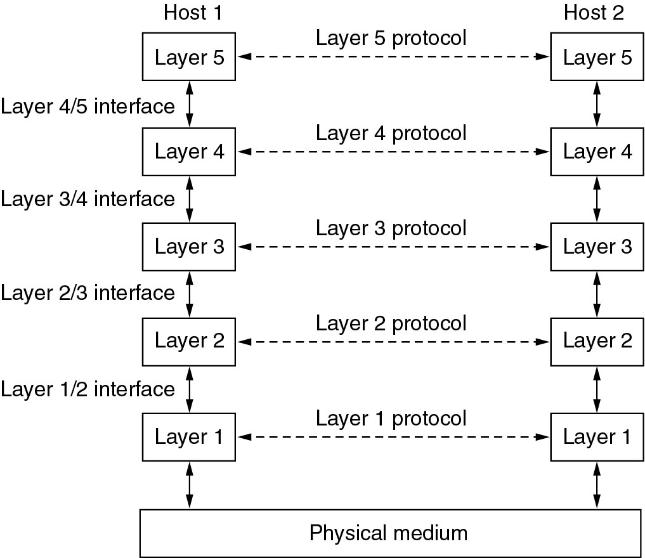
(4.2) The layering Principle (1)

Slide 9
(4.2) The layering Principle (2)

Slide 10
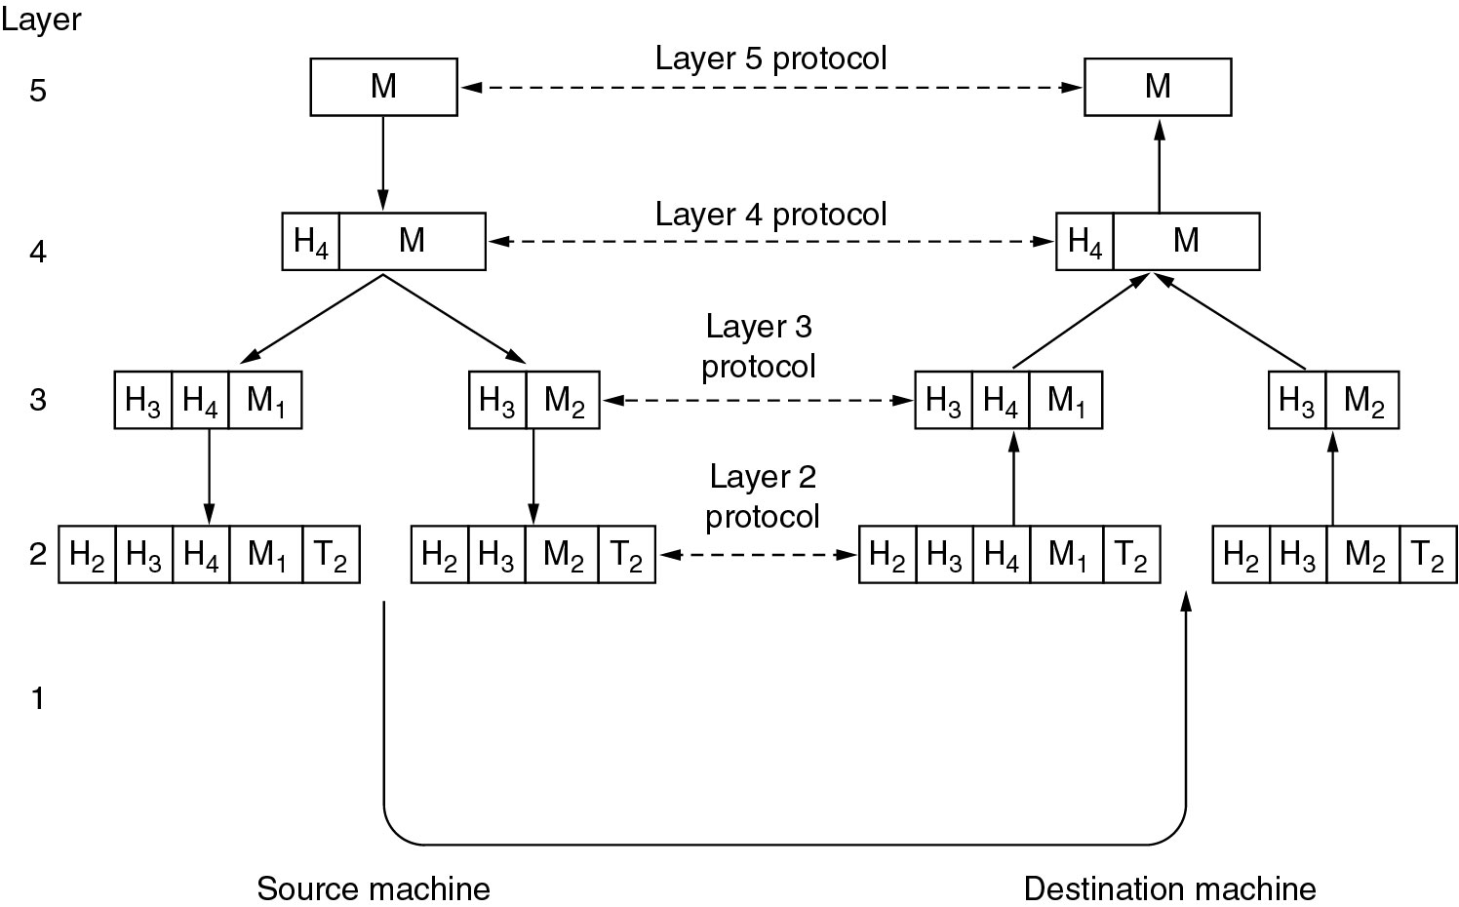
(4.2) The layering Principle (3)

Slide 11
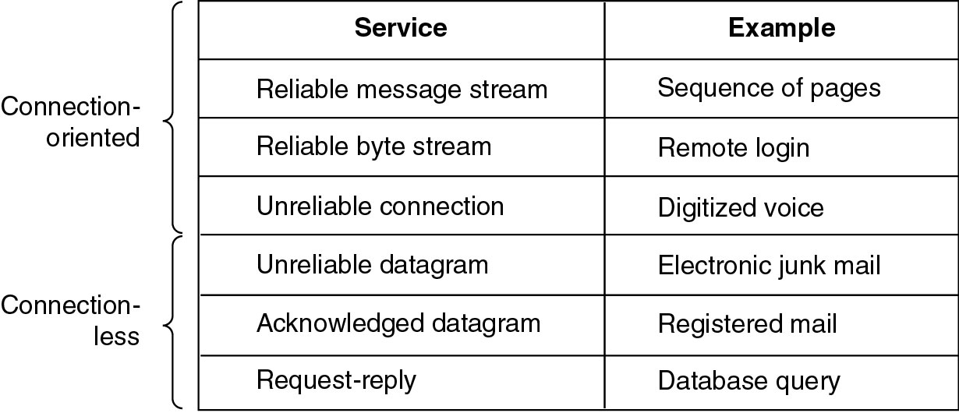
(5) Connection-Oriented vs. Connectionless

Slide 12
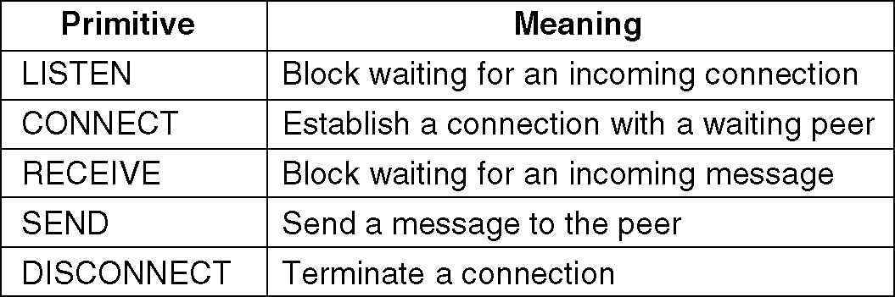
(6) Service Primitives
A service is formally specified by a set of primitives (basic operations) available to a user or other entity to access the service.
Example: five service primitives for implementing a simple connection-oriented service.
Notes:
Another example with html

Slide 13
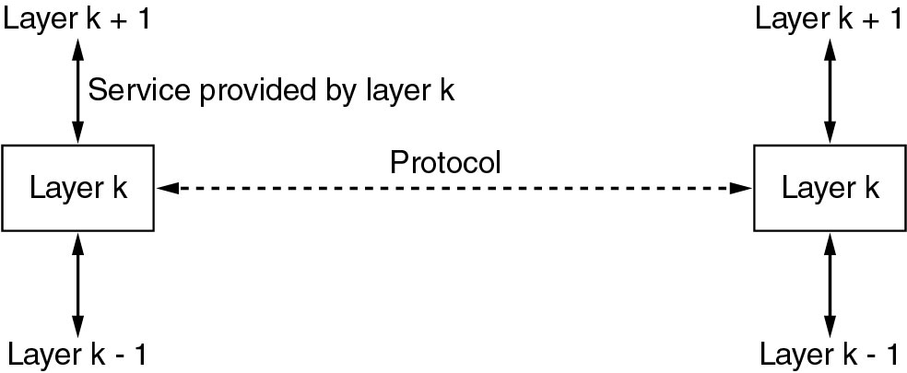
(7) The relationship of Service

Slide 14
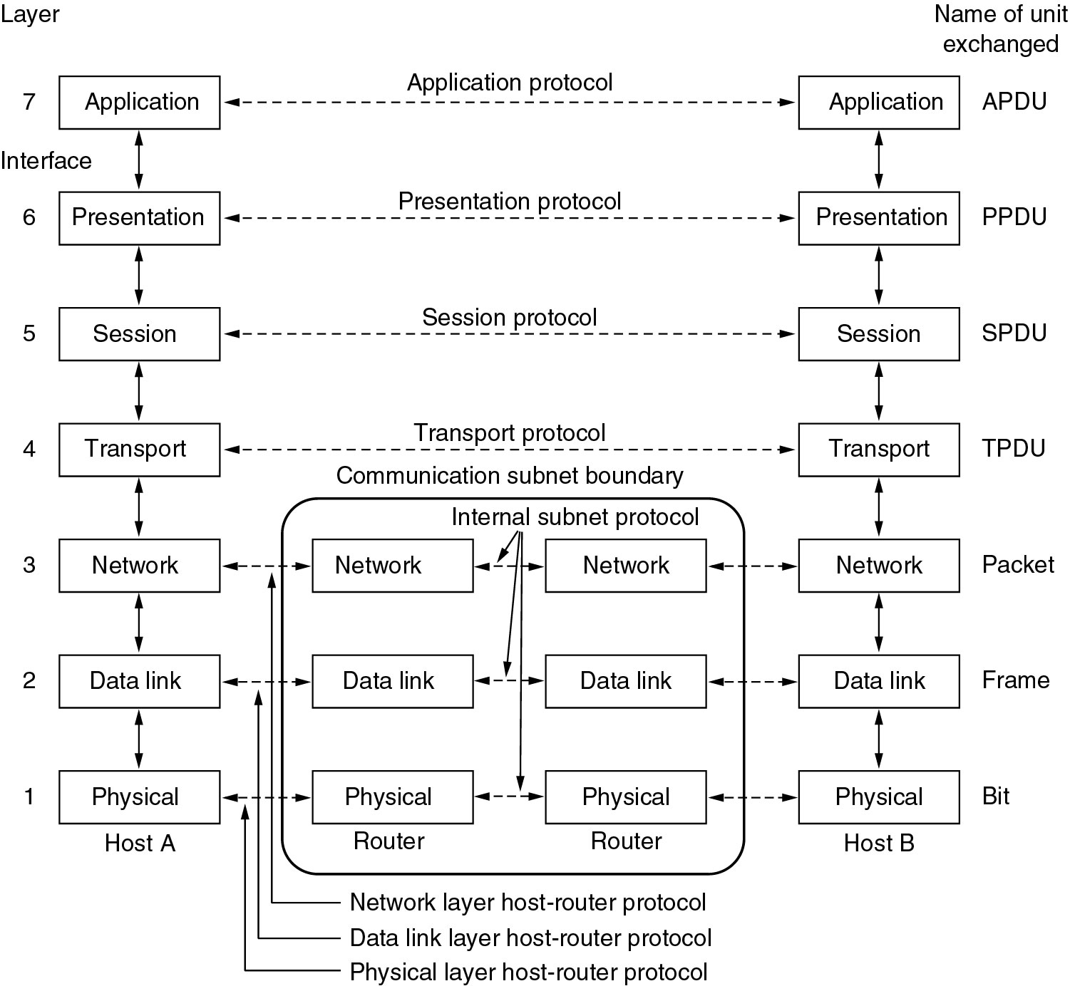
(8.1) The OSI Reference Model

Slide 15
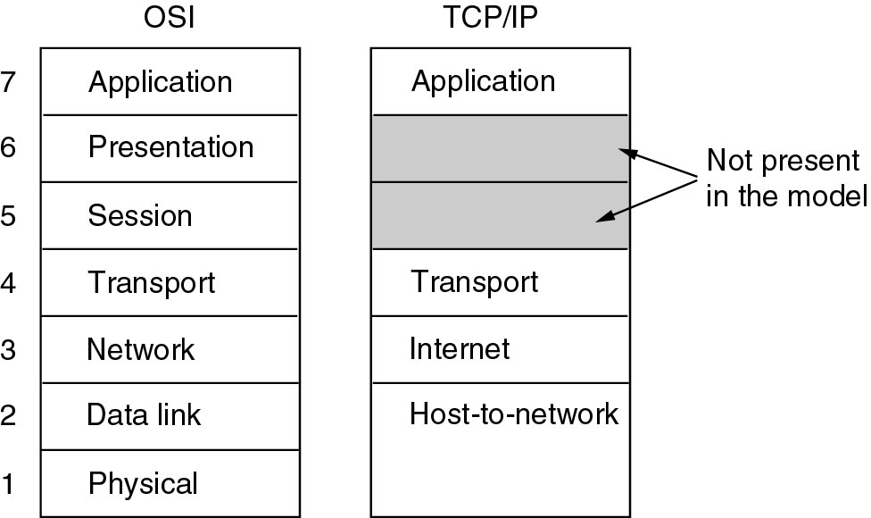
(8.2) The TCP/IP Reference Model (1)

Slide 16
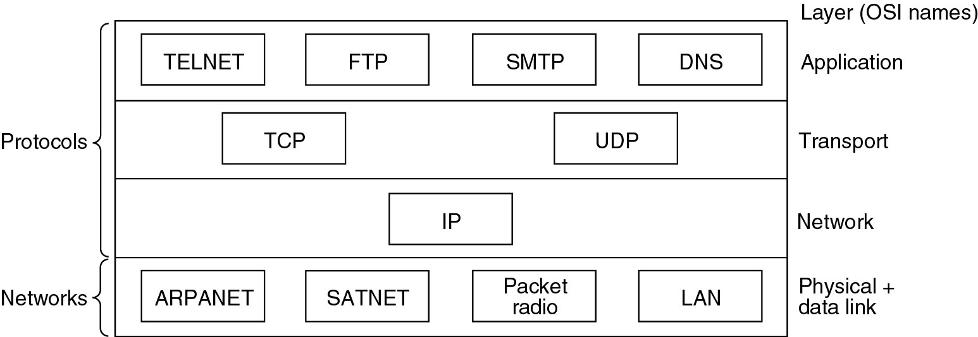
(8.2) The TCP/IP Reference Model (2)
Protocols and networks in the TCP/IP model initially.

Slide 17
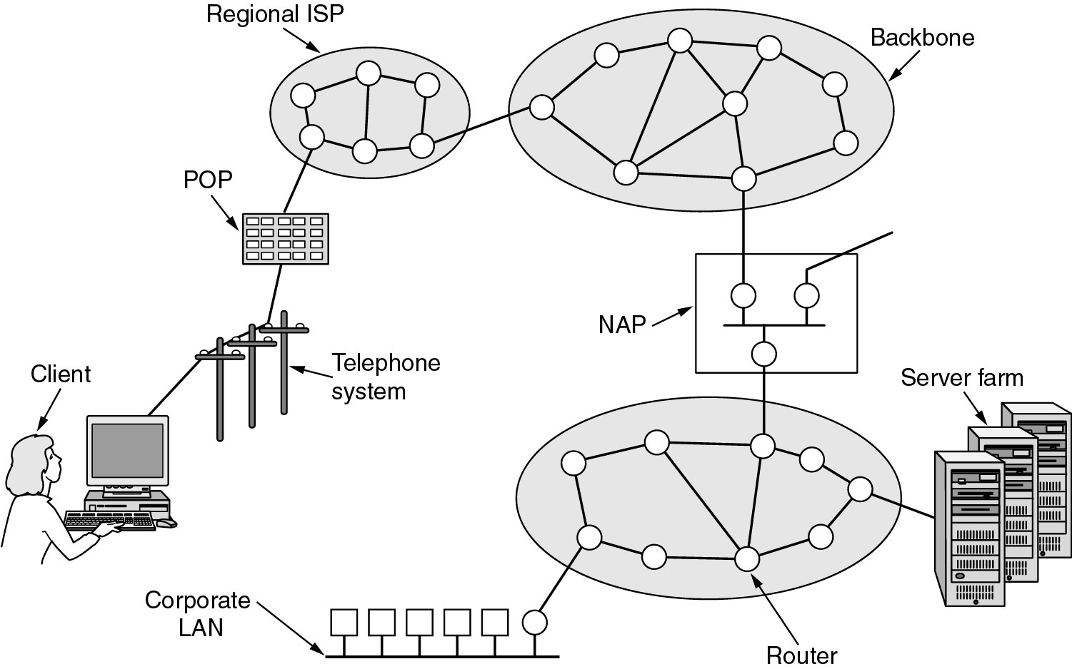
(8.2) The TCP/IP Reference Model (3)
Overview of the Internet.
Notes:
Add a logical view

